Slide 1


HubSpot MDM Contact Matching & Merging
by Jeff Huth
01

Slide 2



Am I already in
your database?
Hi. Here is my Contact record.
Name: Jeff Huth, Phone Number: 800-867-5309x042
Title: Principal Analytics Engineer
Company Name: Wind River Systems
Company Industry: Tech, Employees: 1,500
Email: jeff.huth@gmail.com, Twitter: @drinkdata
LinkedIn: https://www.linkedin.com/in/huthjeff/
03

Slide 3


Agenda
Introductions
Candidate-led code review
Interviewer-led feedback session
Candidate questions & wrap-up

Slide 4














Data Architecture Diagram
dbt Job Orchestrator
countries
Snowflake
DWH
dbt Envs
ISO
Transform w/
SQL & Python
Models, Macros,
& Job
Macro to
Unload CSV
to stage
dev
dev_dwh
dbt_jhuth
contacts
GCS buckets
RapidData
dev-
deploy
source_db
prod-
deploy
dev_dwh
mdm
output-dev
CRM
contacts
Acme
Git Repo: SQL &
Python files
prod_dwh
mdm
output-prod
GCS buckets

Slide 5

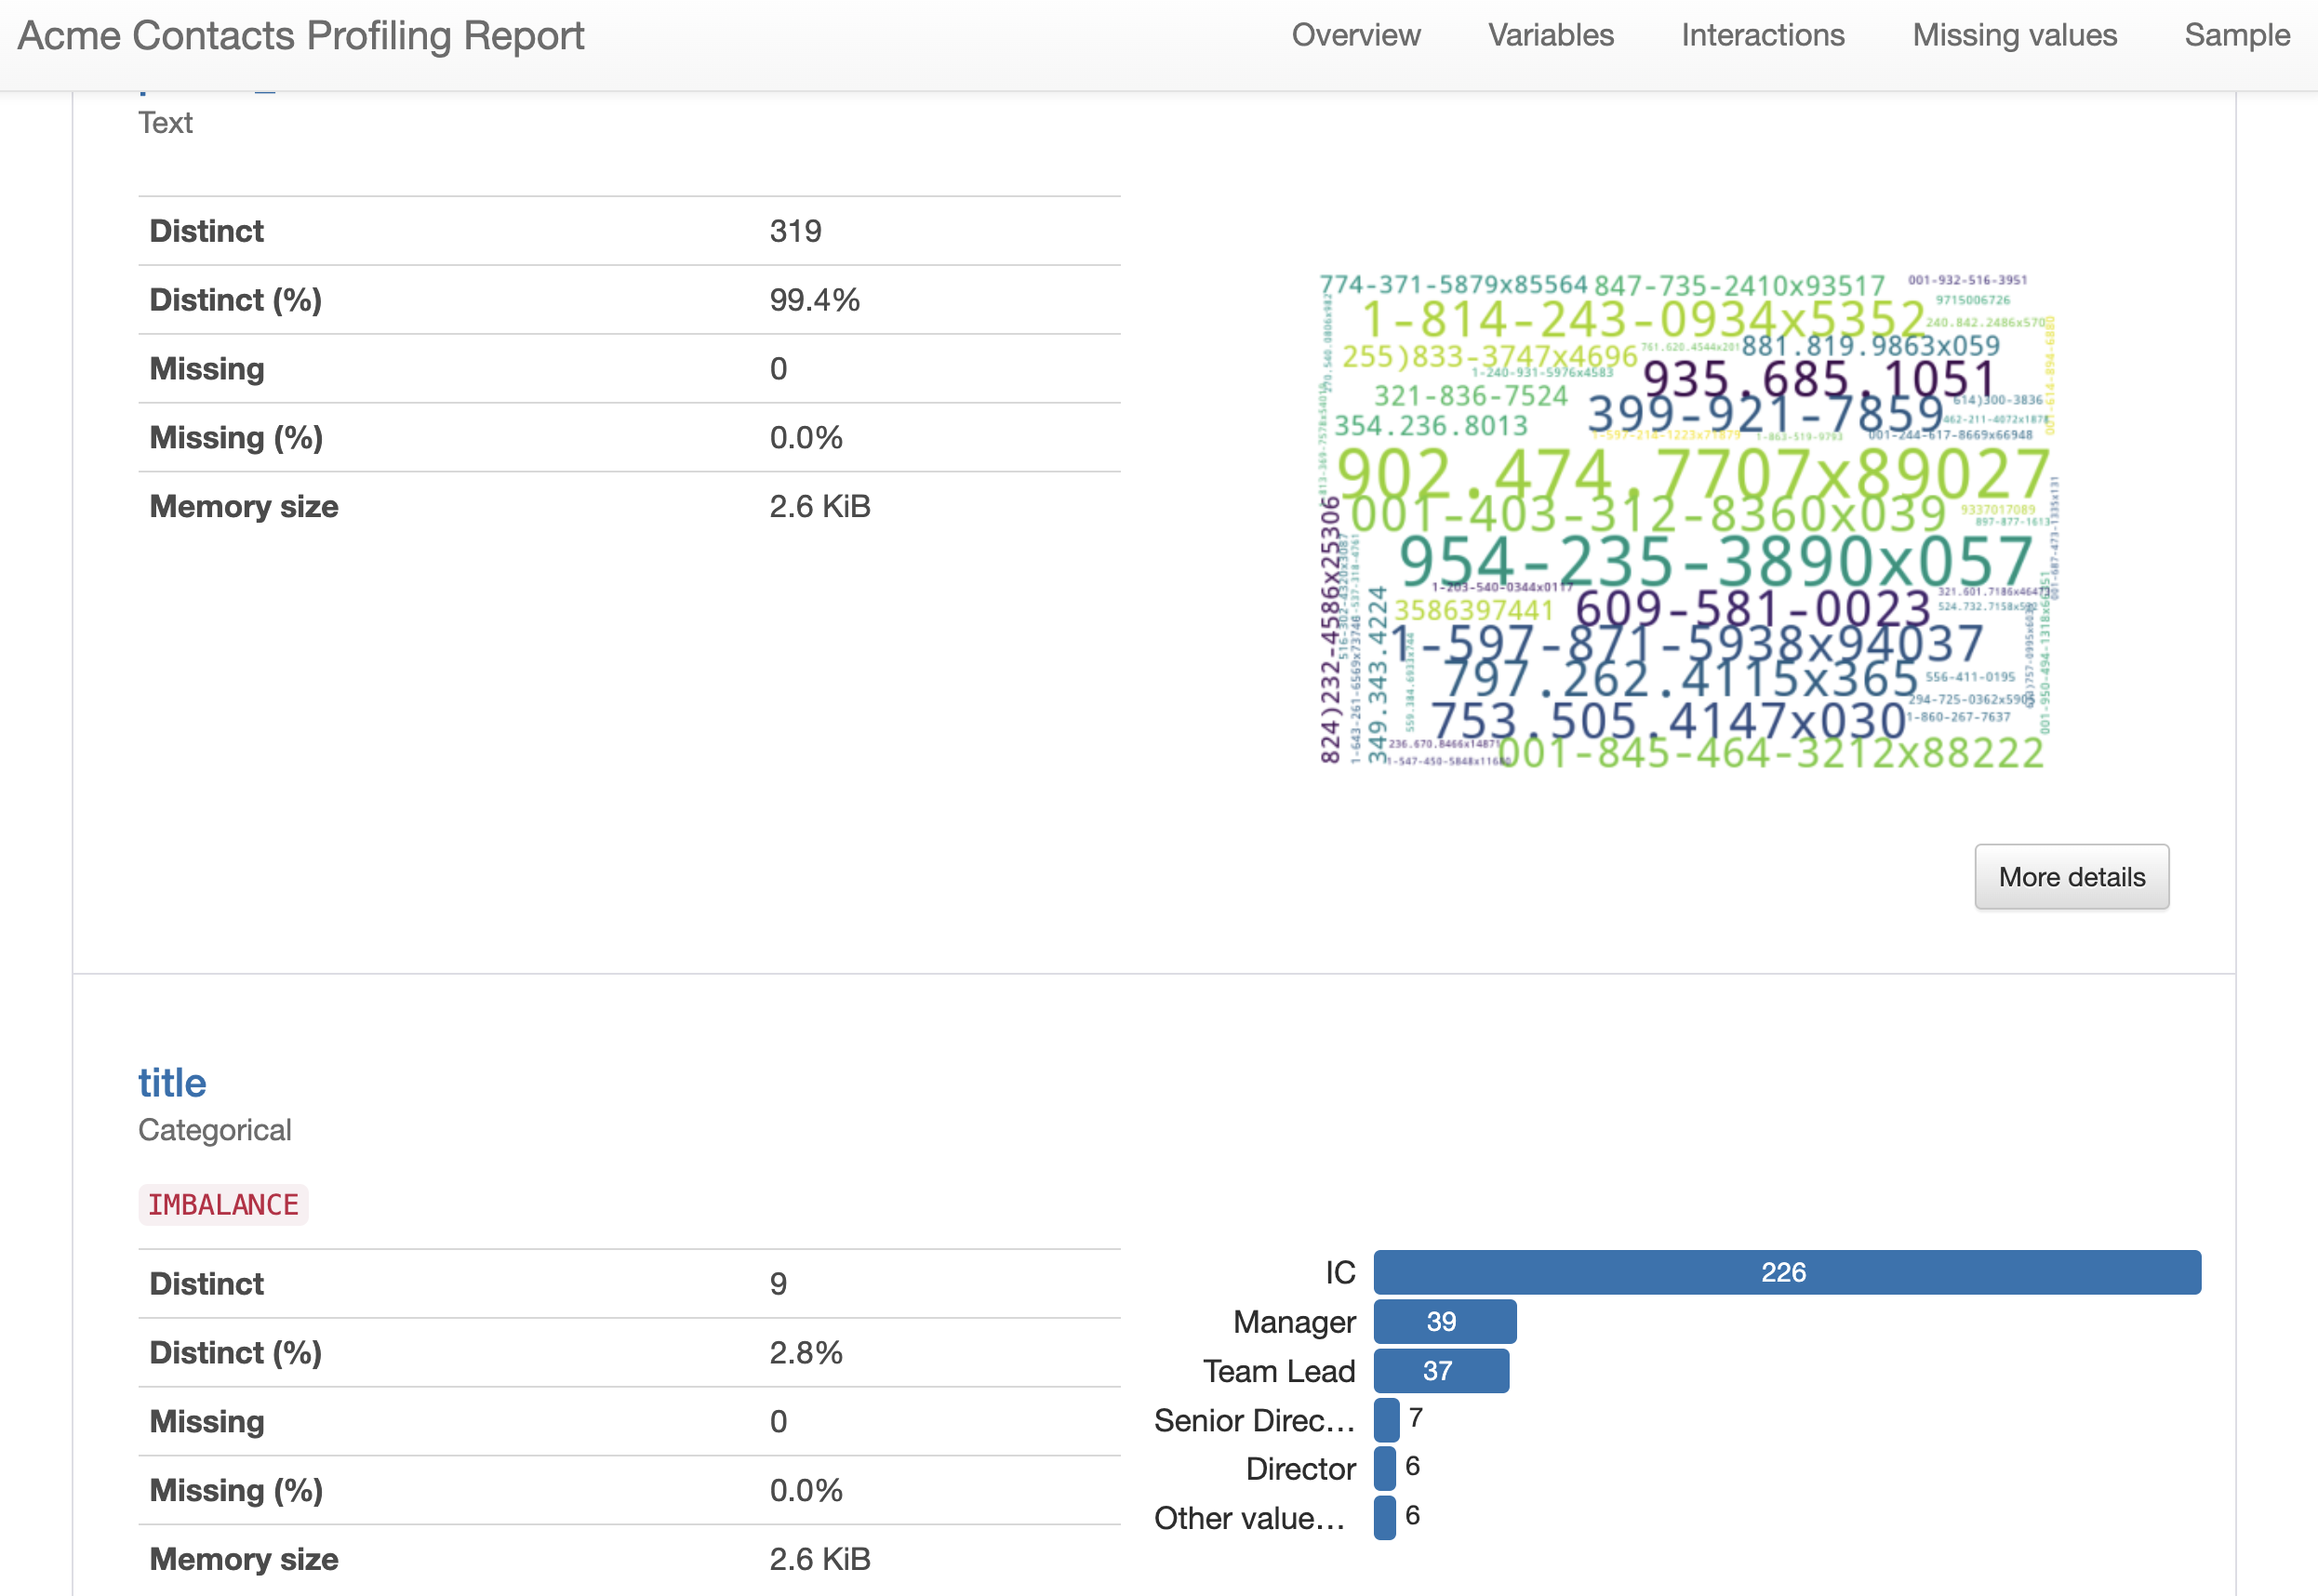
Data Profiling
with Python +
ydata-profiling
Using a Jupyter Notebook
Common fields:
Name, Title, Email, Phone,
Company Name + Domain
Unique field: Email?
Discover common fields, unique fields, attribute values, NULLs
Notes:
Product Screenshot Full MacBook

Slide 6
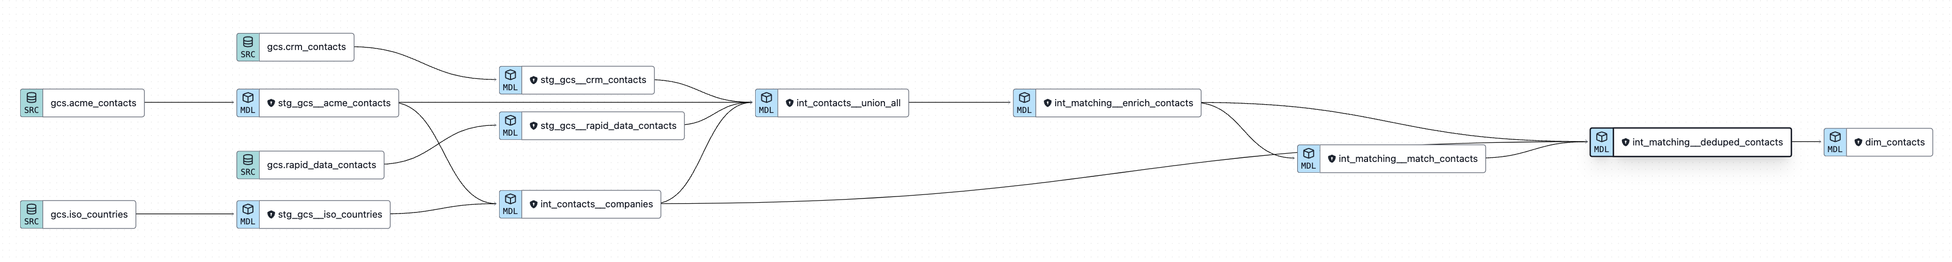
dbt Model Transformations
dbt Job Orchestrator:
dev-build-all
GCS buckets
int_contacts__companies
int_contacts__union_all
int_matching__enrich_contacts
int_matching__match_contacts
int_matching__deduped_contacts
GCS buckets
stg_gcs__iso_countries
stg_gcs__<src>_contacts
contacts
Macro
unload_table_to_gcs
Macro
trigger_gcs_stage_refresh
SQL
SQL
SQL + Python
source_db
stg models
int models SQL
int models Python
marts model SQL
dim_contacts

Slide 7
Python Matching & Merging +
int_contacts__union_all
Union data
Lookup company/country
Basic pre-processing
int_matching__enrich_contacts
Python DataFrames + libraries
Validate: email, phone, domain, IP address
Parse first/last name + first initial
Clean + phonetics (metaphones)
int_matching__match_contacts
Python DataFrames
recordlinkage library:
- Index
- Compare (rules)
- Features
- Matches
De-duplicate match pairs → array
int_matching__deduped_contacts
Join enriched + merge keys
De-duplicate Contacts
Entity resolution
- Contact ID (first record)
- Latest record: name, etc.
- Latest valid email & phone
- Latest src specific fields
- Company info lookup
contacts
Normalize & pre-process w/ common fields
Clean, Validate, & Parse
Match & Merge

Slide 8

Assumptions
Files delivered to GCS from sources
Data is USA, Canadian, European
- UTF-8, Latin alphabet
- Name/phone/email formats
- Dates in UTC, Currency in $$
Different people based on differences in: name, email, phone, company, title
Most recent record is the best & most up-to-date
Matching rules: 4 (or 5) of 7 compared attributes
06

Slide 9
Challenges
BigQuery vs. Snowflake? Python
Snowflake Snowpark Conda libraries available
dbt Python models on Snowflake
recordlinkage (matching) library – getting distinct & unique match key sets
Airbyte community connectors (GCS)
GCS to Snowflake: stages, external tables
06

Slide 10
Next Steps
Improve matching rules (indexes, rule types)
Add scoring/weighting rules
AI/ML: Investigate other algorithms
Reporting: Visualize and alert
Orchestration w/ Dagster + Airbyte + Snowflake + dbt
Data security: Roles, Grants, PII, encryption
CI/CD Pipelines: dbt, Dagster, GitHub workflows
06

Slide 11

Thank You!

